Slide 1
Using Microsoft Excel
Notes:
Microsoft excel is a really useful programme for helping us visualise data.
Today we’re going to follow 3 simple steps to use Excel to digitise (which means type up) data we collected outside last time and then create some cool charts so that we can work out what is going on.
I’m going to talk this through as a power point presentation first, and then you can follow the steps on a worksheet to make you own graphs.

Slide 2
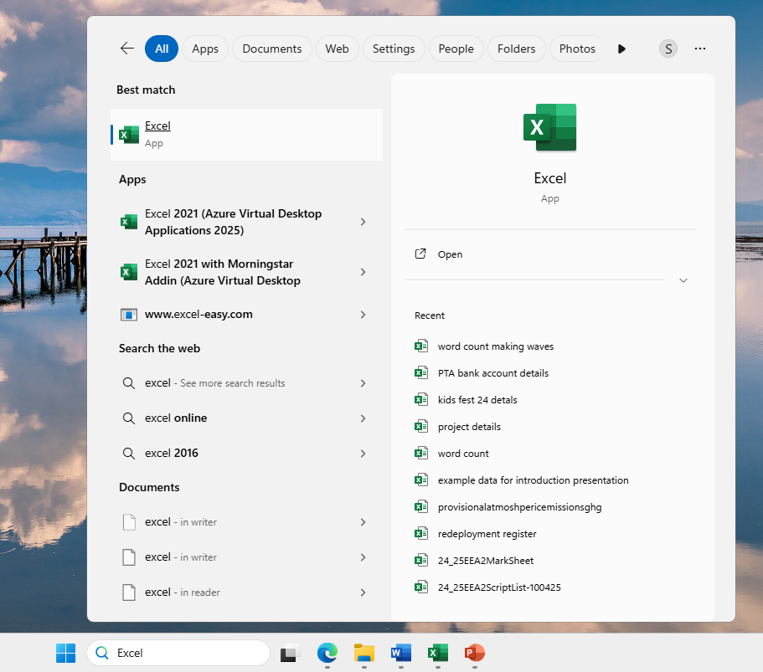
Notes:
Microsoft Excel should be on all school laptops and you can open it by double clicking on this symbol in green, (*click*) which may be on the desktop.
Or you can search for the app by typing “Excel” (spell it out) in the search bar of your laptop.
This is where the search bar is on my laptop (*click*), but don’t worry it might be slightly different on yours.
Just click on the Excel App to open it (*click*).
Easy peasy

Slide 3
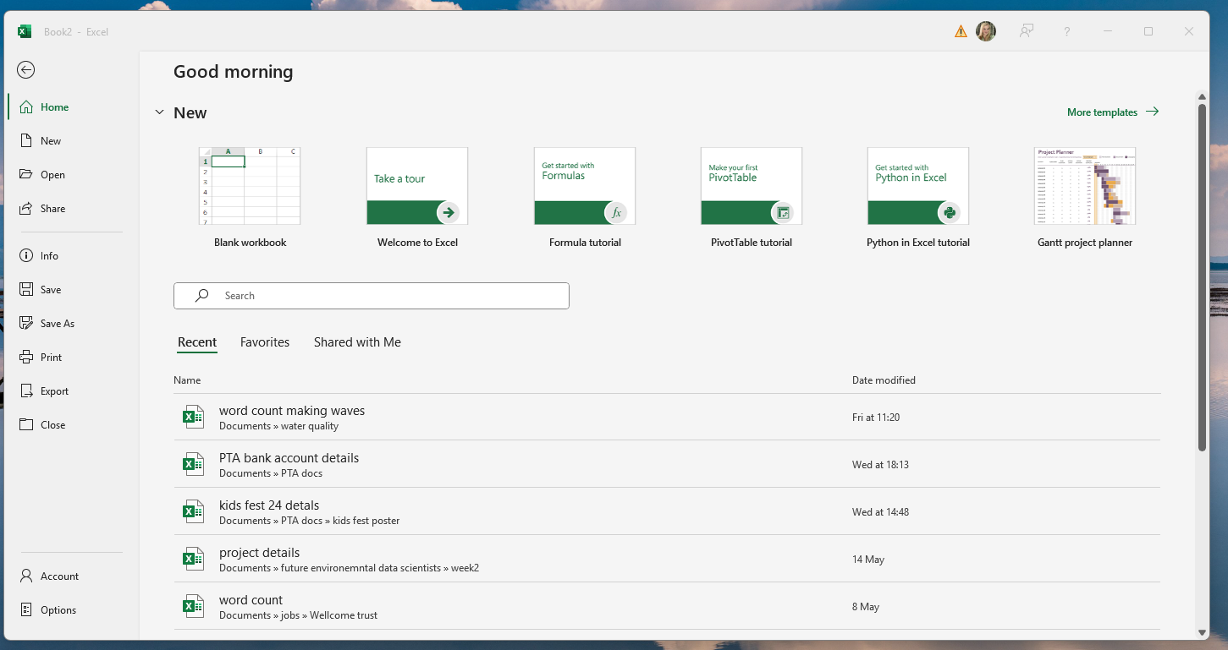
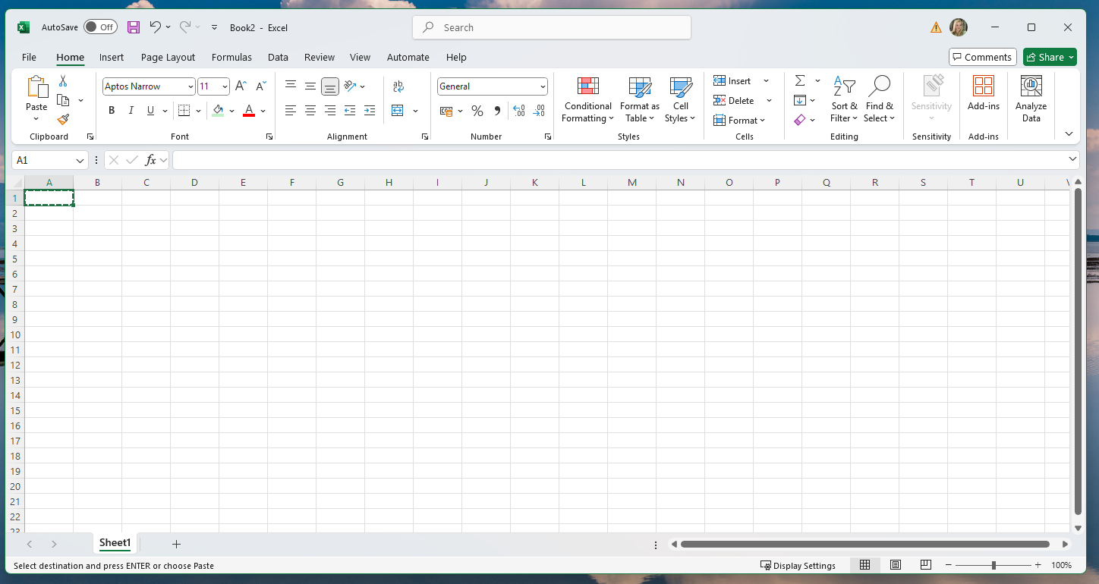
Menus
Text changing buttons
Columns
Worksheet
Rows
Cell
Notes:
Once you open the programme click on the blank workbook, which is here (*click*), this should open an Excel worksheet which should look a bit like this. (*click*). If you’ve used Microsoft Word or PowerPoint before you might be familiar with this layout, but I’ll go over some main parts.
First of all, (*click*) just a like you use a menu in a restaurant to choose what you want to eat, you can use the menus along the top here to choose what you want to do. The home menu, which we are currently on, lets us change the text font, size, colour, and lots of other fun things. Using these buttons underneath it (*click*). These options or buttons change when you click on a different menu. We’ll talk more about the other menus later. For the moment, let’s stay on the home menu.
The most important part of Excel is the worksheet here (*click*) – think of this like a worksheet or a bit of paper you would normally write on. It’s just has lines drawn on it to split it into columns (*click*) lettered A to Z and rows (*click*) numbered 1 to infinity, each rectangle is often called a cell (*click*). The worksheet is where we are going to put the data we collected for our projects. Everyone following?

Slide 4
Text box (click to change text)
Notes:
So we have our empty worksheet – a bit like a blank piece of paper. Now let’s fill it with our data.
How your data will look will depend on your project, but I’m going to put some data in from my made up project of butterflies.
First you need to type columns names – basically what is our data ging to show (a bit like headings when you are writing work).
To type in a cell (remember this is the name for the rectangles) just move your mouse (the white cross or arrow on the screen not a real mouse) (*click*) to click on the cell you want to type in. And then just start typing using the keyboard. You can change the text by clicking on this text box (*click*) and using the left and right arrows and backspace on the keyboard, if you make a mistake.

Slide 5
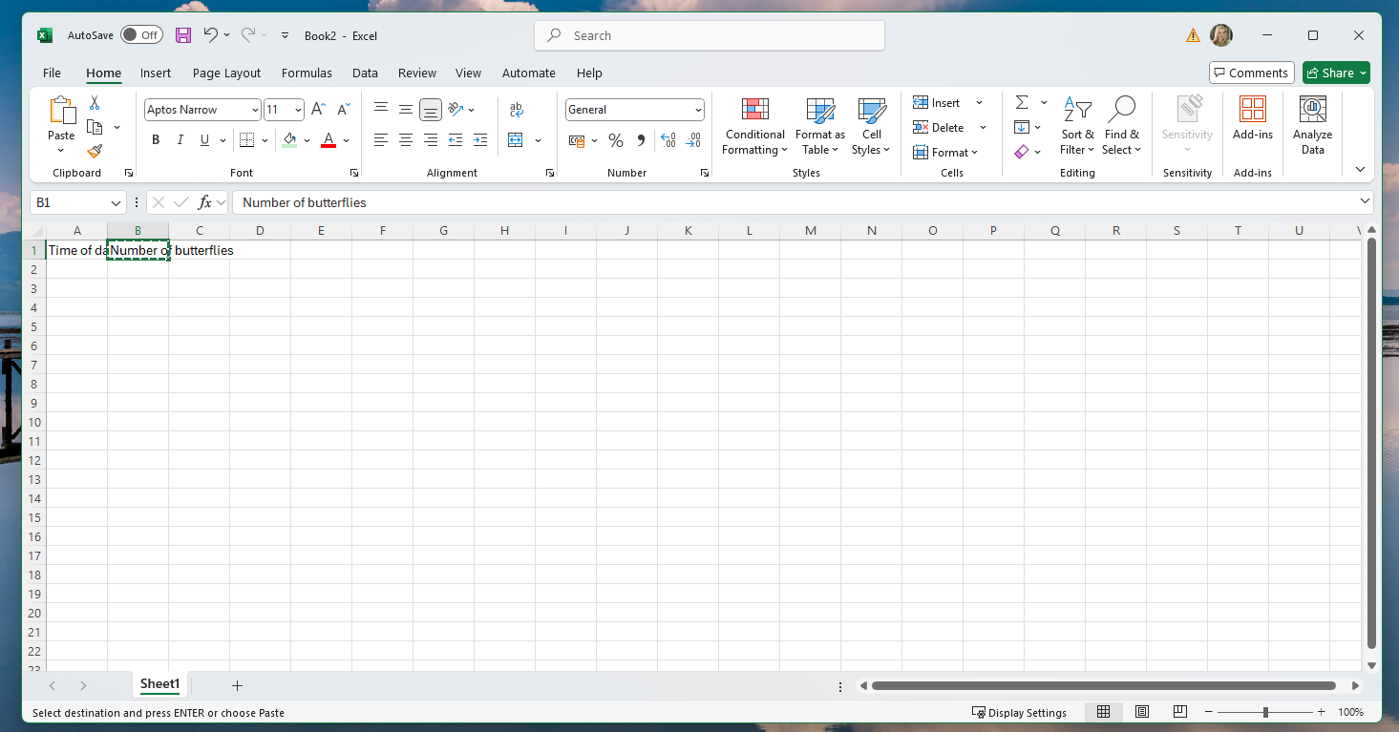
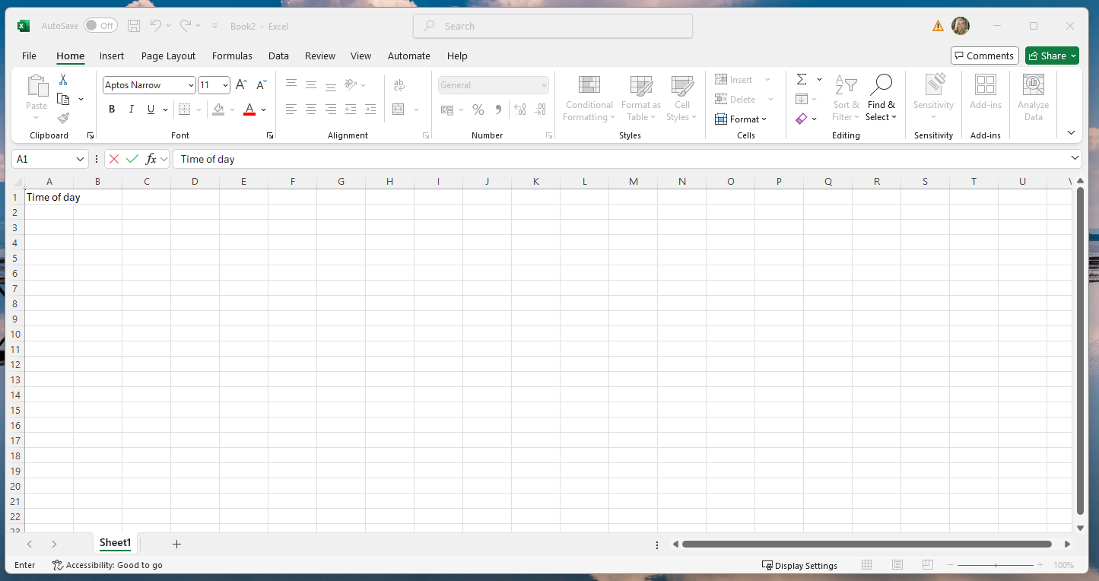
Notes:
I’m going to type “time of day” as the heading for the first column – in cell A1 here (*Click*)
And type “number of butterflies” as the heading for my second column in cell B1 (the 2nd column) here (*click*)
Let’s make this a bit clear by zooming in a bit by clicking the plus on the zoom scale (bottom right) (*click*) to a 160% or so.

Slide 6
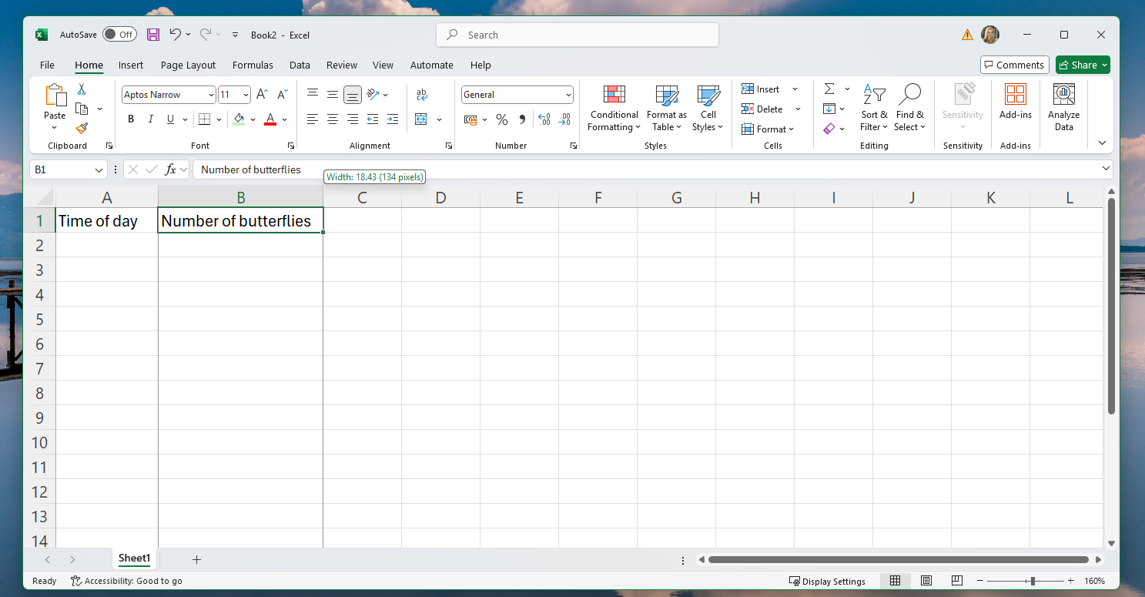
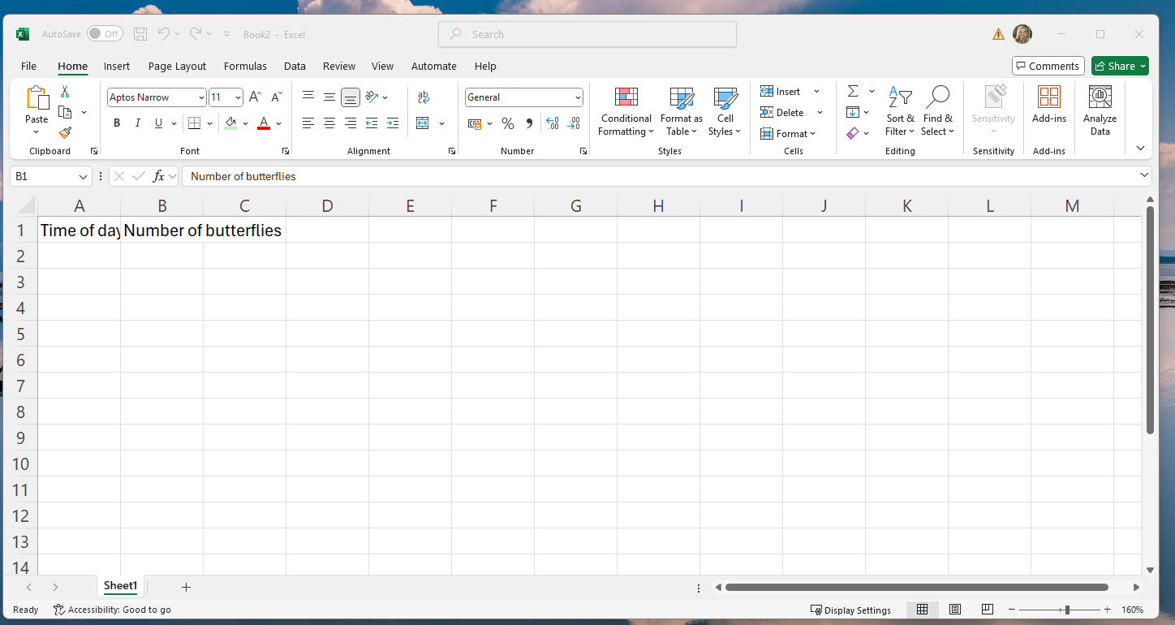
Notes:
Ah, that’s better
Do you notice that not all the letters fit in the cell, especially for time of day? We can make our columns a bit wider so that we can see all the text. To do this move your mouse to hover over the grey line between A and B, it should turn into a black line with two arrows, like this (*click*). Now click, hold the click down, and drag to the right to make the column wider, stop holding the click when you are happy with the width (*click*).
Now we have a worksheet with column headings – but no numbers.

Slide 7
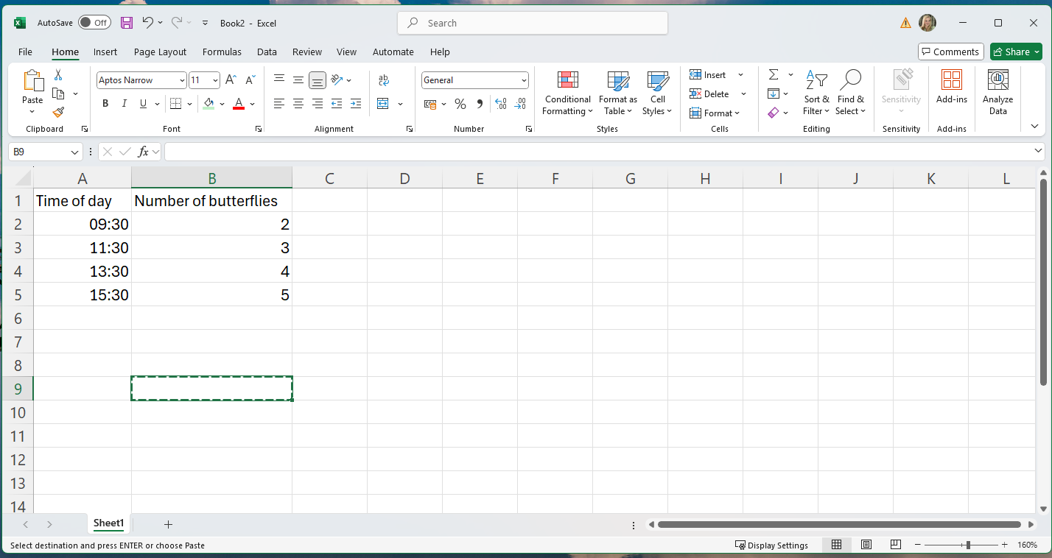
Notes:
To add numbers, like before, just click on the cell you want – for example A2 (*click*) and add some numbers.
The press enter or the right arrow to move to another cell and type more data.
And tah dah, you have digitised your data.

Slide 8
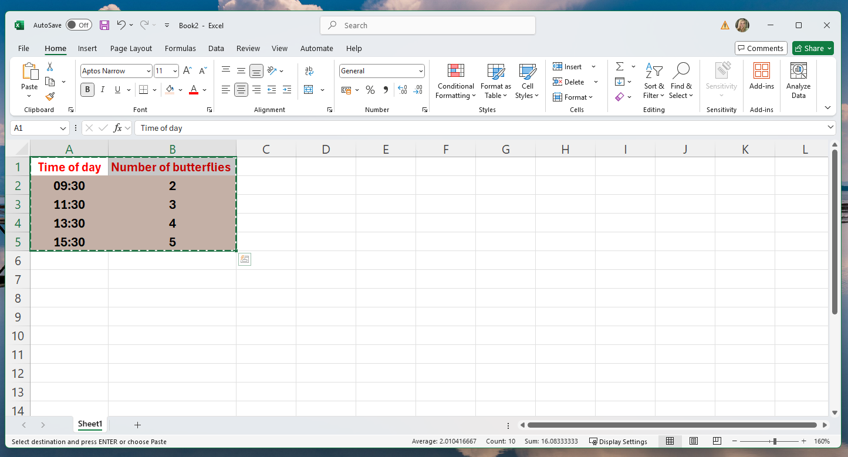
Notes:
You could experiment with changing the font, size, and colour of the data using these buttons (*Click*).
Just select the cells you want to change first – try clicking and dragging the select more that more cell
You could try making something like this (*click*)

Slide 9
Notes:
Now we have the data in Excel the next step is to make some cool charts.
Again, the type of chart you make will depend on your project.
Examples and summarise chart types.
I’m going to use my example butterfly data to make a line graph to show how butterfly numbers change during the day.
To do this:
Click on at A1, then click and hold the click down to drag to B5. This selects all your data (you’ll know you’ve done this right if the cells go grey and have a green border
Next go to the “insert” menu here (*click*), this will give you some cool new options

Slide 10
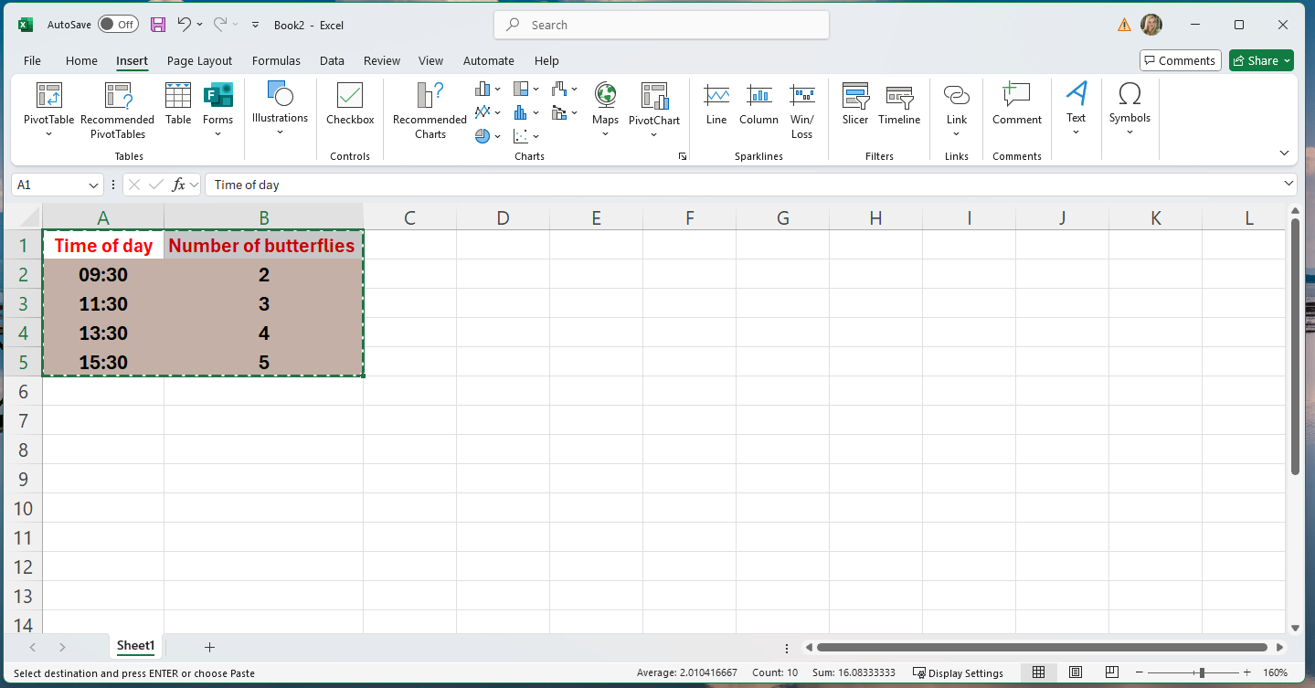
Notes:
We’re interested in the charts, here in the middle (*click*).
Because we want a line graph, click on the line graph option here (*click*). You can hover over each chart with your mouse and should get a description of that chart.
Click on the line graph button and you should get more choices!

Slide 11
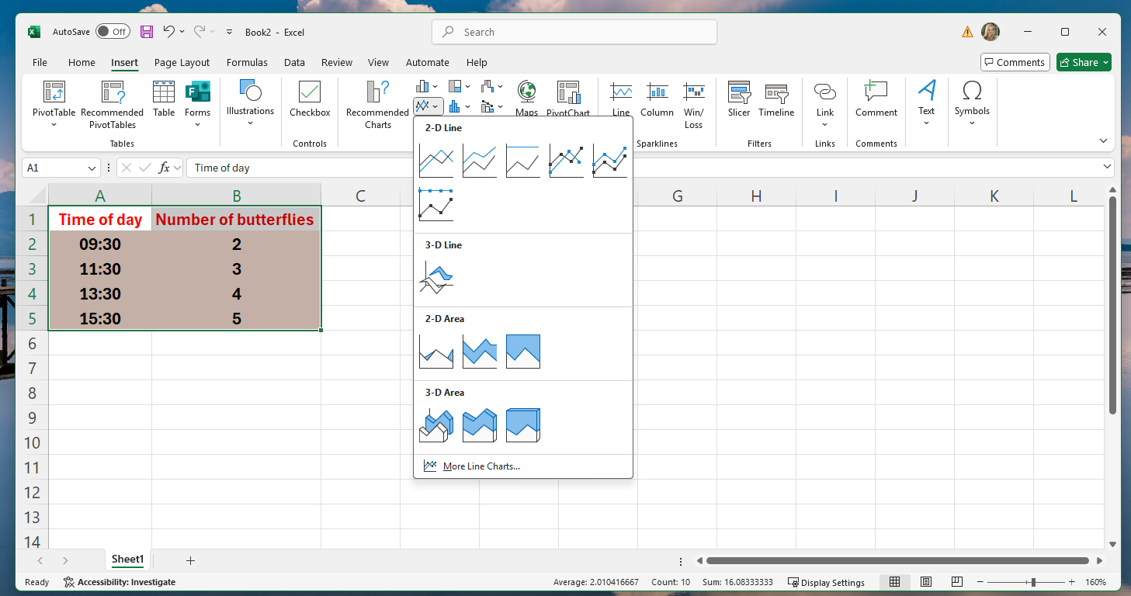
Notes:
Click on 2D line shown here (*click*)
You can explore other options later – some of the 3D options are fun.
When you click on the line chart it should magically appear!

Slide 12
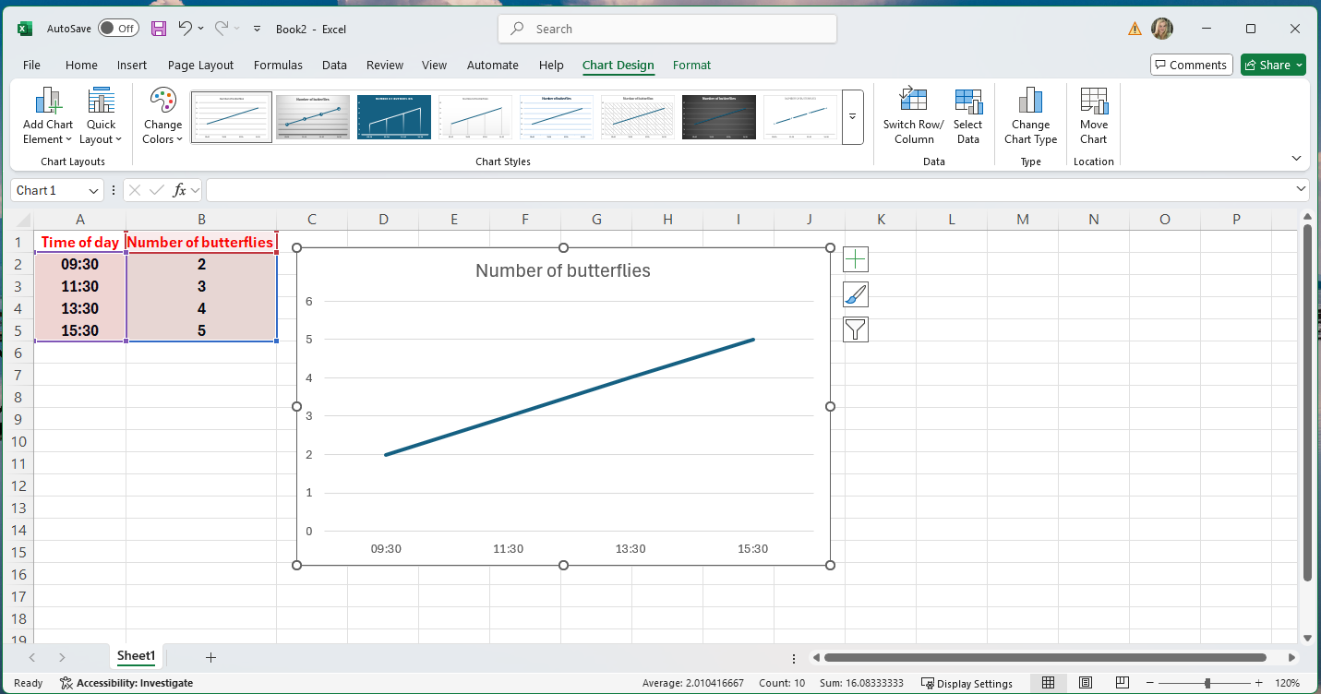
00
Notes:
Here it is! I’ve had to zoom out a bit to fit it on the page.
You’ll notice a new menu has appeared called “Chart design” here (*click*).
You can change the chart styles but clicking on different options here (*click*) and using the down arrow to get more options.
Also look at different colour schemes here (*click*).
The best way to learn about chart design is to play around with it.
You can click on parts of the chart to change the colour, font etc.

Slide 13
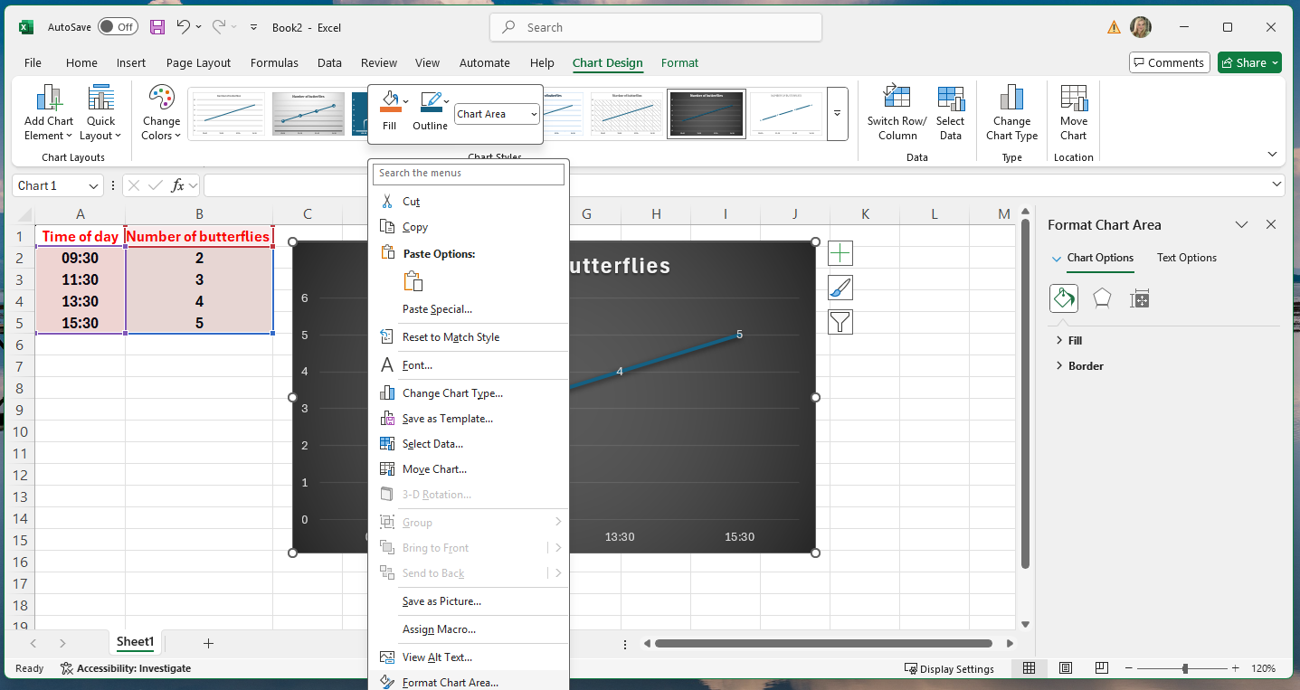
Notes:
You can also right click (not the usual left click) anywhere on the chart and then click on “format chart area” here (*click*)
This opens a new option bar on the right side. Shown here (*click*) where you can do extra cool things like change the fill/background colour.
Just click on “fill” (*click*) and then experiment with some of the background options.

Slide 14
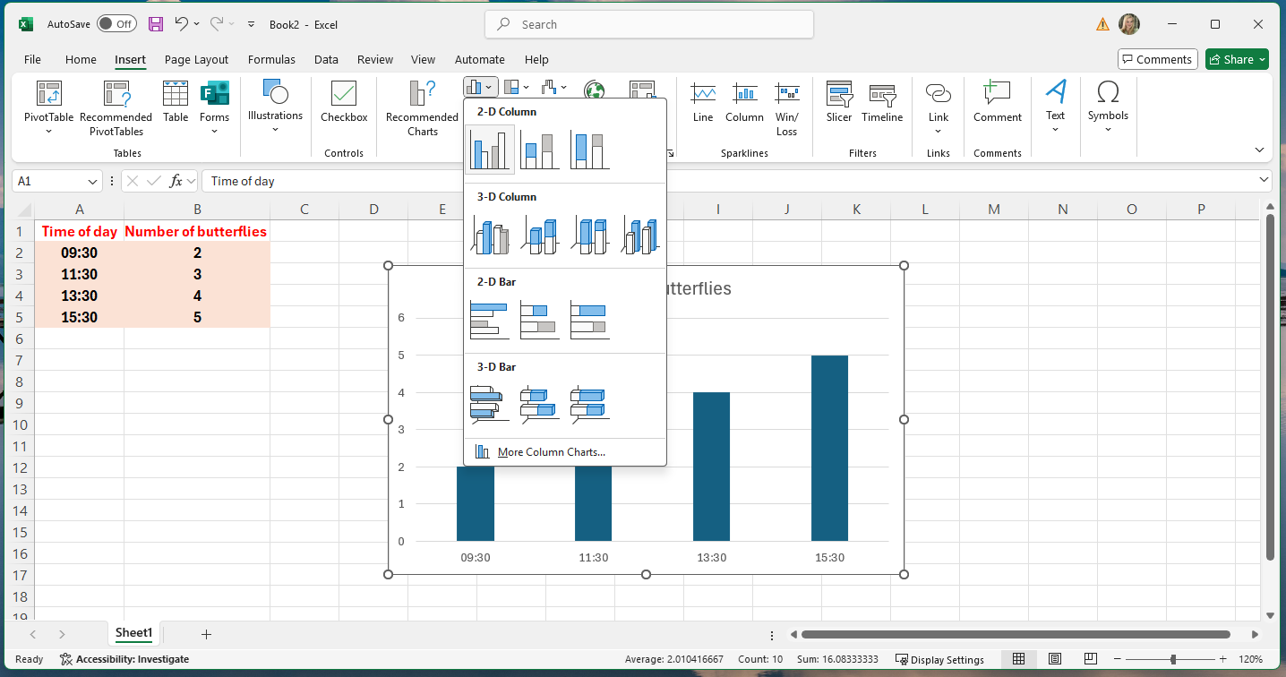
Notes:
You could have also used these measurements to make a bar chart.
This is exactly the same process:
Select all your data by clicking and dragging
Go to the “insert” menu, then the chart section in the middle
Select “Column or bar chart” and then the first option “Clustered Column”
This will give you a bar chart that you can experiment with the chart design as before.

Slide 15
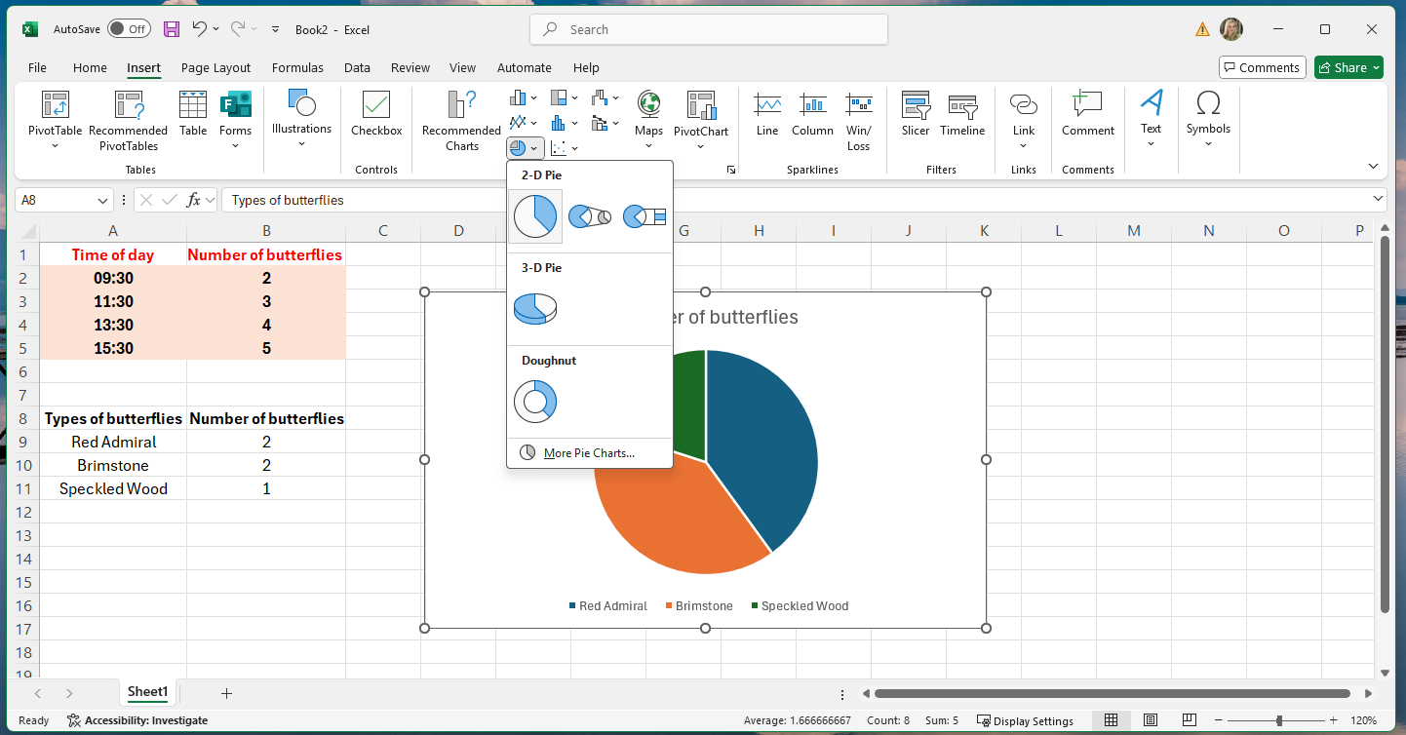
Notes:
The last type of chart you might want to use is a pie chart. This is used when your data can be split into categories, for example different types of birds.
Here’s some example butterfly data.
To make this into a pie chart it is the same as before:
Select the data
Insert menu -> charts -> Pie or Doughnut chart -> 2D Pie

Slide 16
Line chart
Bar chart
Pie chart
Notes:
Here are some charts I made earlier. A line chart, bar chart, and pie chart. They all show the data is a slightly different way and help us understand what is happening in the environment.
Does anyone want to tell me what they show?
To copy them from Excel to Powerpoint you just right click on your chart in Excel, then click on copy. Now open Powepoint, right click in the slide and click on paste (note this may change the chart formatting to match the powerpoint slide, to stop this happening click “Paste keep source formatting”

Slide 17
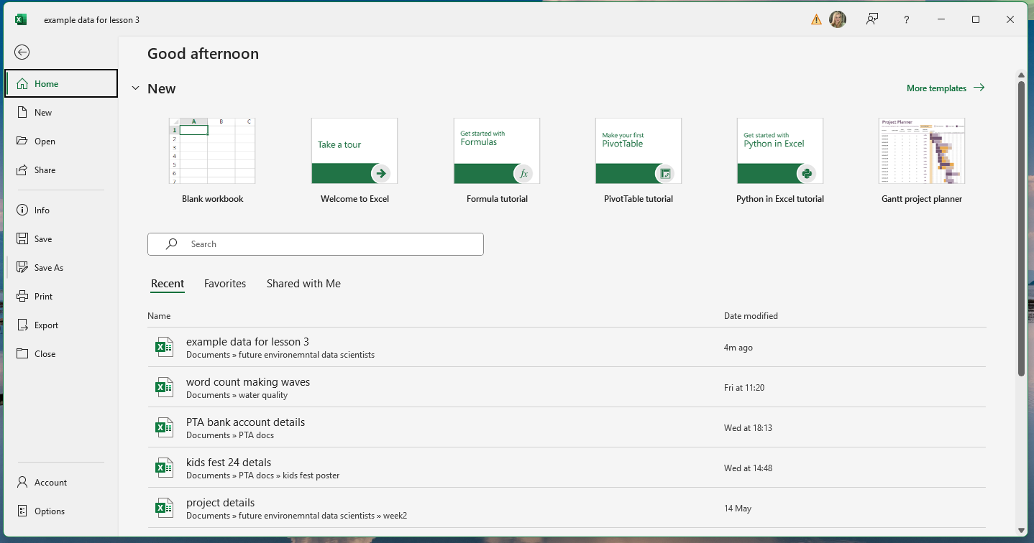
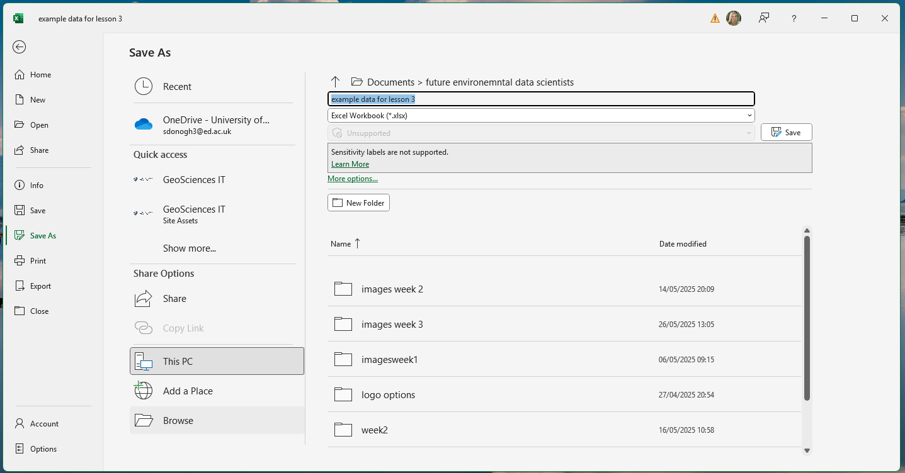
Notes:
One last thing. Always remember to save your work. To save you Excel sheet, go to the “File” menu, then click “Save as” (*click*)
This opens a new window like this (*click*). Type a name for your worksheet in the text box here (*click*), and make sure “Excel Workbook” is selected from the drop down menu here (*Click*).
Then click save (*click*).
This means you can open your data anytime.

Slide 18
Line chart
Bar chart
Pie chart

