Slide 1





Making maps in QGIS
Notes:
In this lesson we make some cool maps using a programme called Quantum GIS (QGIS for short!). GIS simply makes maps on the computer. It works by stacking lots of layer with different information – a bit like drawing lots of pictures on tracing paper and then putting them on top of each other. QGIS is also a bit like Google maps but you can draw on it and add extra information which can be really useful.
Today we’re going to follow four easy steps to make your own map of the environmental data you collected. These maps will be really helpful for your presentation next week.

Slide 2

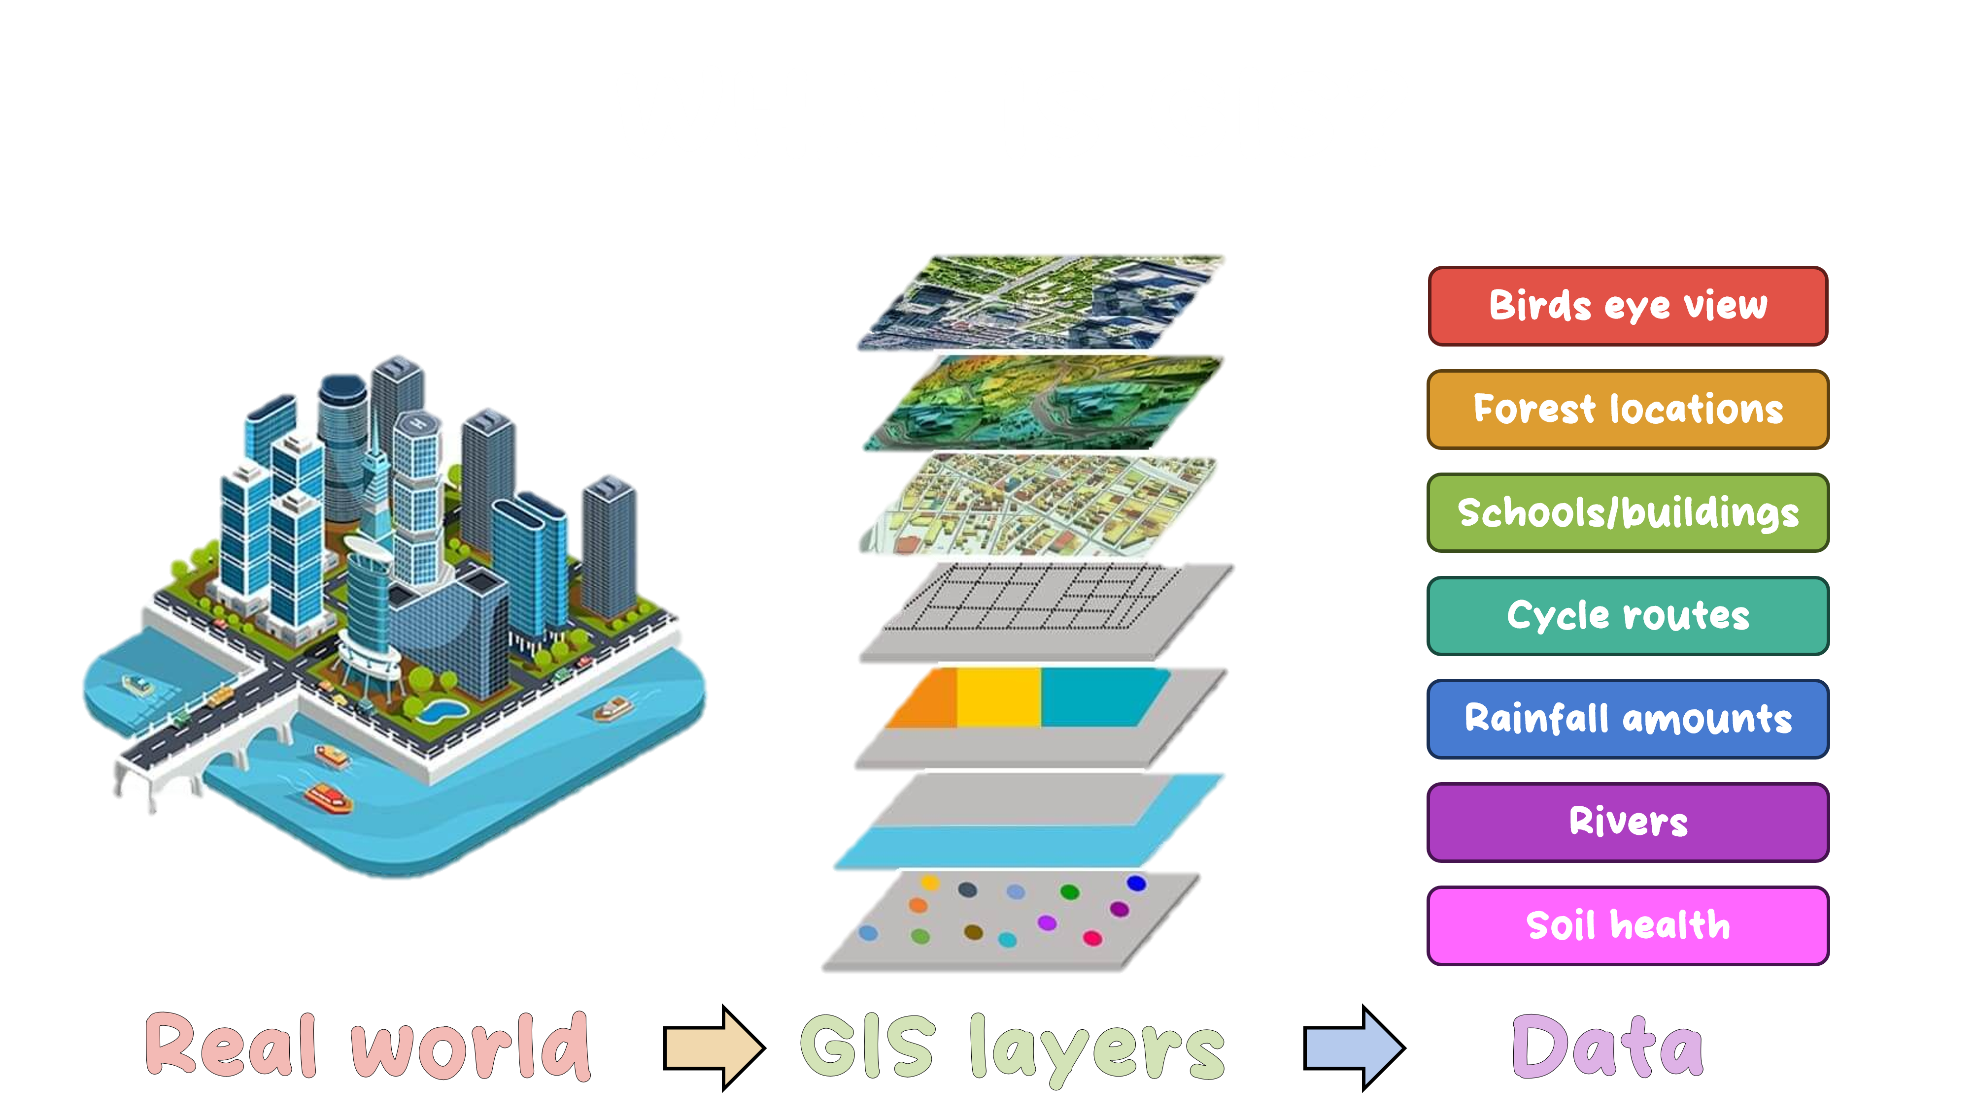
Notes:
GIS stands for Geographic Information System. That might sound like a big, tricky name, but it’s actually a fun and powerful tool that helps us make maps and learn about places! GIS simply makes maps on the computer., but think of GIS like a magic map. Imagine you have a map, but this map doesn’t just show streets and places, it can also show:
Where animals live
Where forests are
Where it rains the most
Where schools and parks are
Even where the soil is healthy or polluted!
GIS helps us put lots of different kinds of information together on a map so we can understand the world better. It works by stacking lots of layer with different information – a bit like drawing lots of pictures on tracing paper and then putting them on top of each other – like in this middle image. This is all based on data – just like you have been collecting you your project.

Slide 3
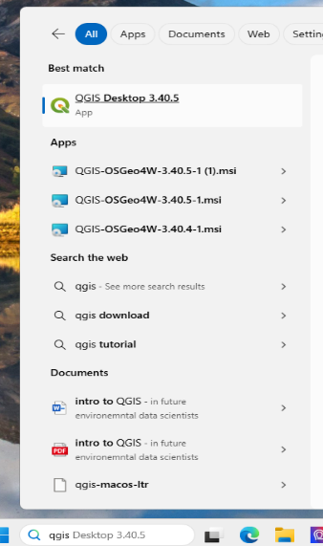


https://qgis.org/download/
Notes:
The first step is to download and open QGIS – I’m hoping QGIS will be downloaded on your device ahead of this lesson, if not go to gqis.org and download the online installer, then follow through the instructions on page 2 of the pdf.
Once QGIS is installed, type it in the search bar of your laptop (this is where it is on mine) then click to open the app.

Slide 4
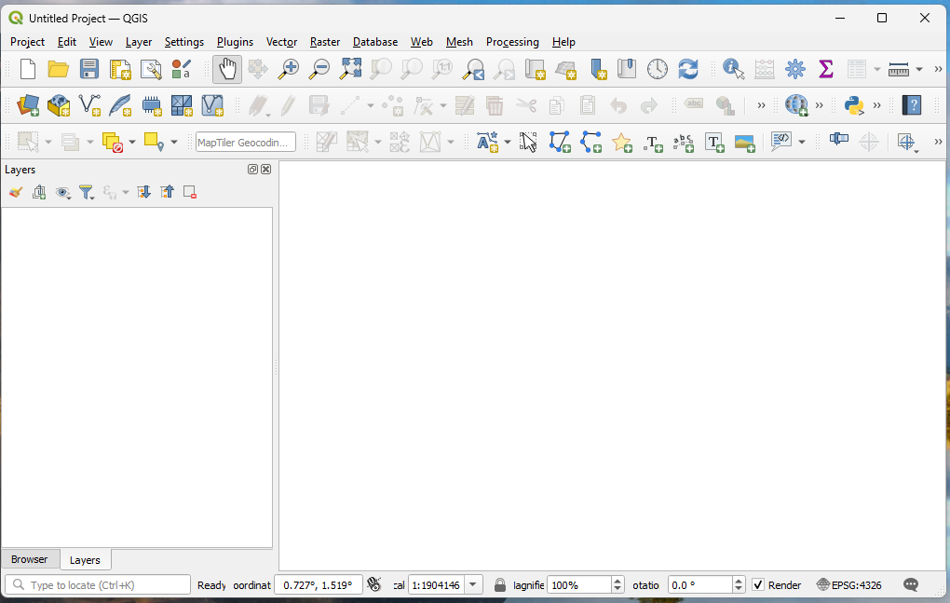
Menus
Zoom and move buttons
Layers
Display
Notes:
When QGIS opens double click on “New Empty Project” template.
This should open a screen a bit like this
QGIS is laid out a bit like other programmes you’ll have used. There is the menu options along the top (red box) and buttons underneath which will help you do things – like zoom in and out (orange box). On the left hand side there is the layers box (green box), this is where you’ll add your different images to build up, a bit like lots of pieces of tracing paper. Remember the layer closest to the top of this box will be most visible, and you can make layers appear or disappear by ticking the box next to them – more on this later. The main screen (blue box) is when you’ll display you maps, you can click and drag to move around this box or zoom in and out.

Slide 5


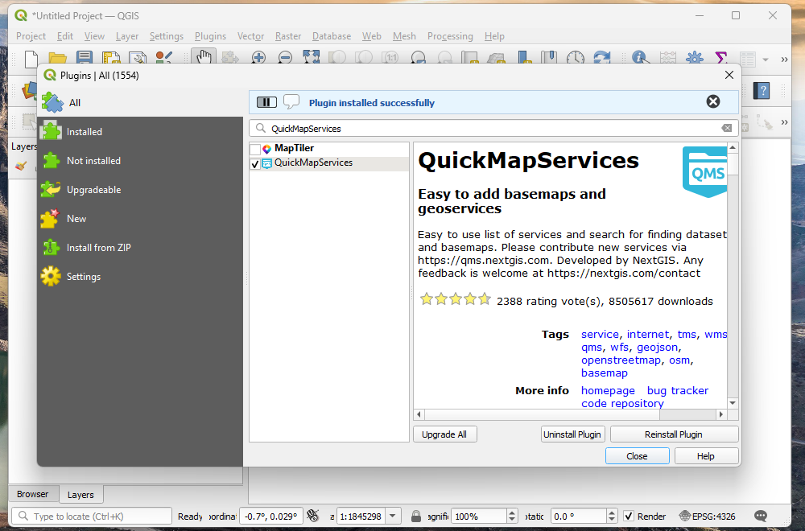
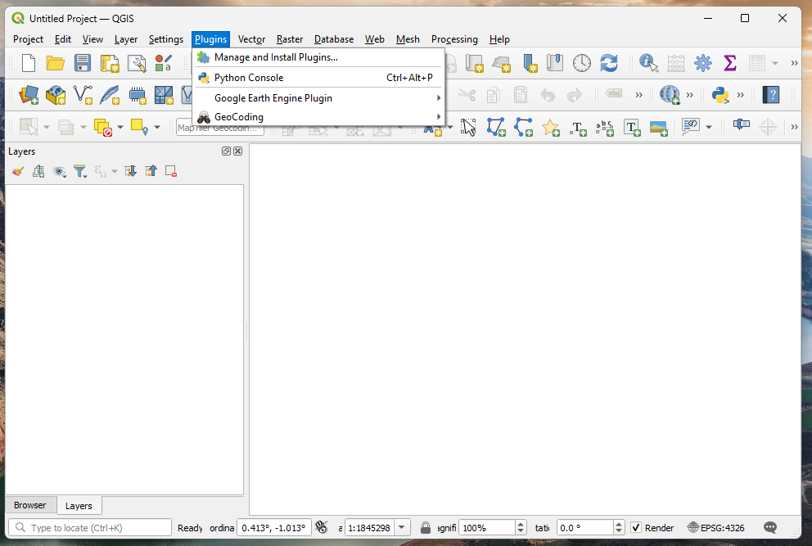
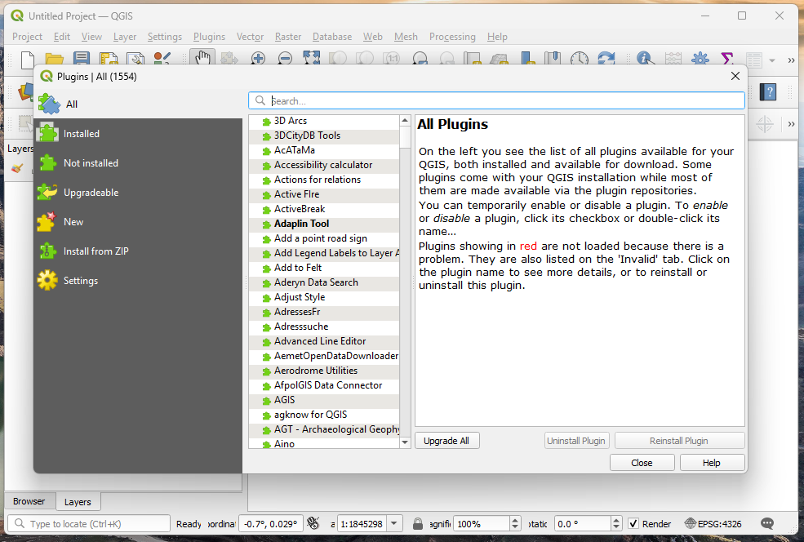
Notes:
We’re going to use the QuickMapServices (QMS) plugin (a plugin is just an extra part to the programme that you have to load the first time you use it). The QMS plugin will be used to load some background maps (also called base layers). These background maps could be Google Maps, but you could also look at OpenStreetMap (OSM), and Bing Maps.
The first time you do this you need to download the plugin by:
Click the “Plugin” menu from the top banner (red box)
Click “Manage and Install Plugins . . . “ (orange box). This should open the Plugin manager.
In the search box type “QuickMapServices” (green box). Select this from the list (blue box).
Click “Install Plugin” button (purple box). “Plugin installed successfully” should appear in blue.
Click “Close”

Slide 6
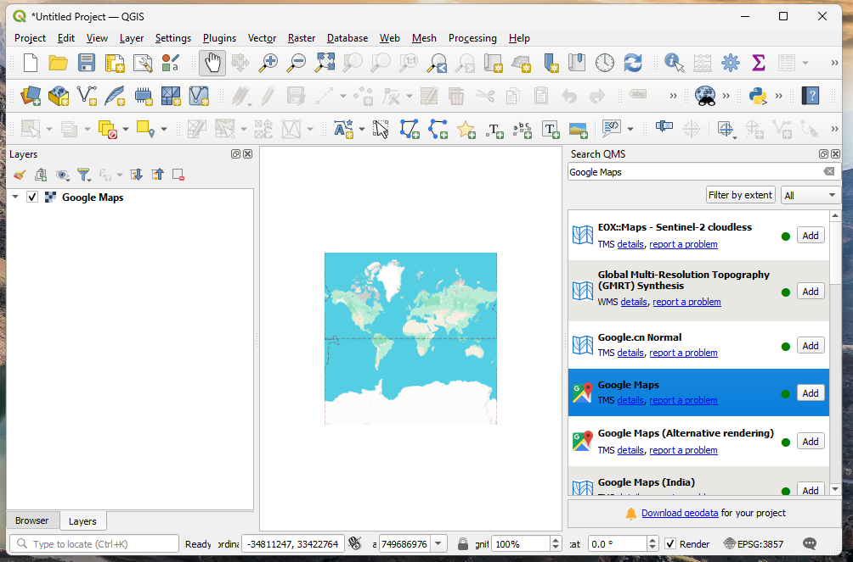
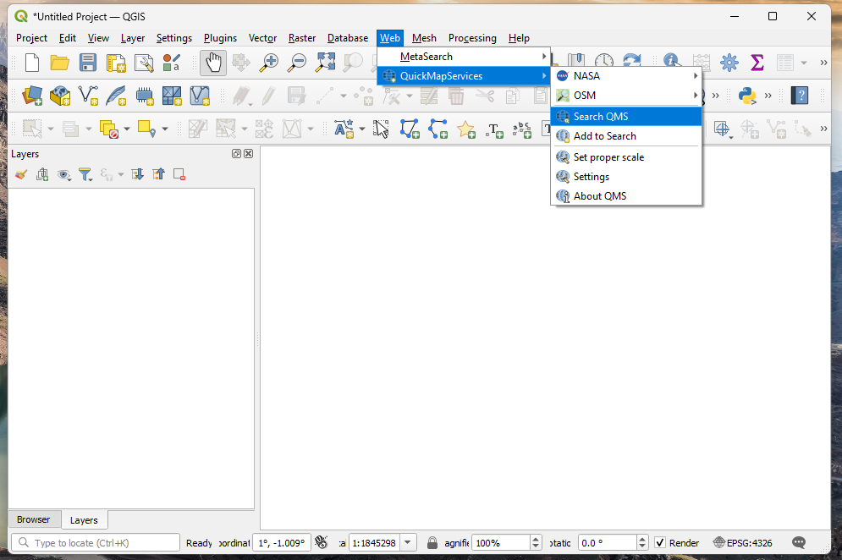
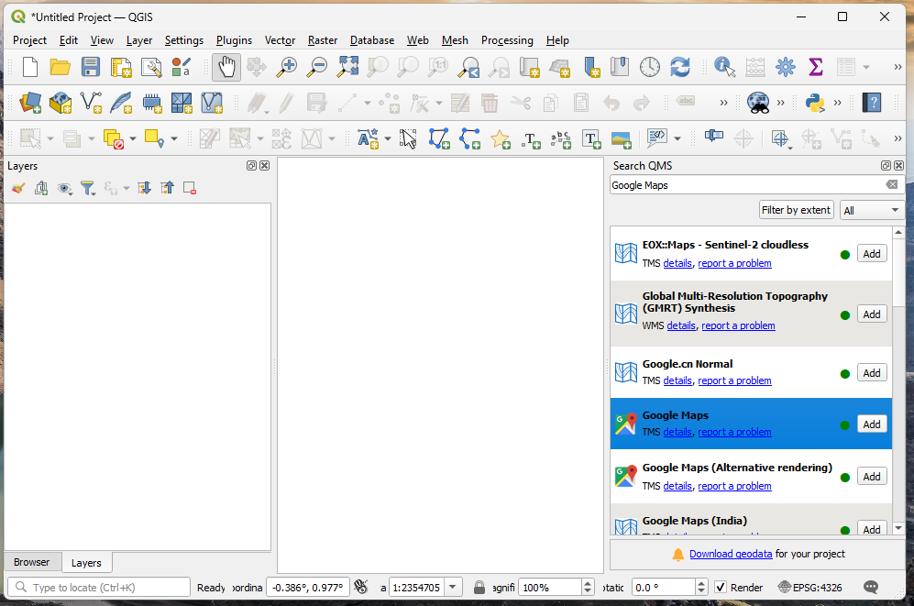
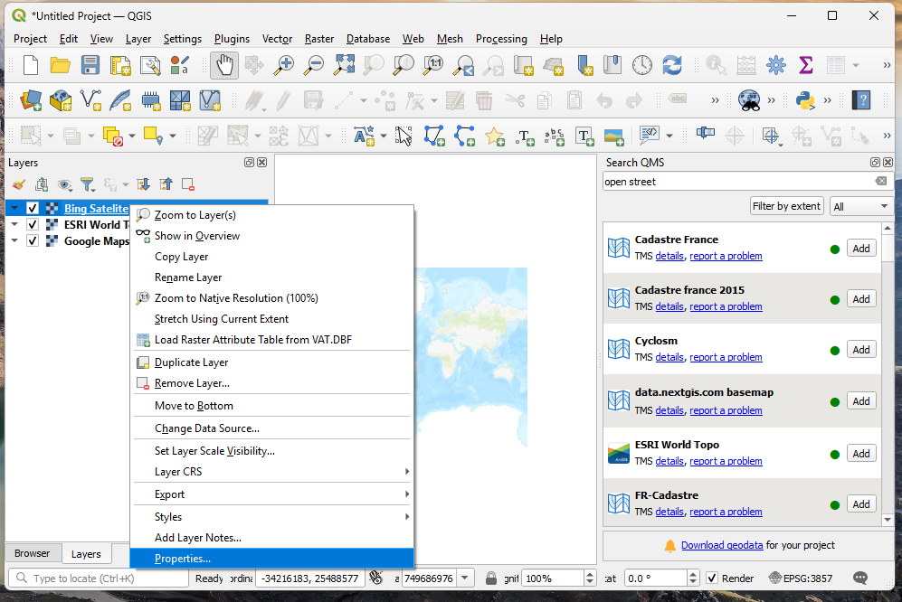
Notes:
Hooray! Now that the plugin is installed and activated, we can load some layers.
Once QMS is installed it should open a “Search QMS panel” on the right of your QGIS window. If this panel does not appear, go to the “Web” toolbar, then select “QuickMapServices”, then “Search QMS panel”.
In the search box (red box) type the name of a basemap e.g. try ‘Google Maps’, ‘ESRI World Topo’, or ‘Bing Satellite’. Click the “add” button (orange box) once you’ve found a basemap you like (hint: avoid adding maps with the blue and white wavy lines symbol).
This will display the full extent of the map in the main window (the whole world in this case). It will also add the map to the layers menu on the left (green box).
Repeat step 2 to add a few more different base maps. Experiment with ticking these layers on and off in the layers menu (or dragging them to the ‘top’), so that you can then compare them. You can also right click on the layer name in the layers panel then select “properties”, to find out more information about each layer, and alter how it displays. Try change the transparency. Click the X in the top right of the layer properties menu to get back to the main display.

Slide 7


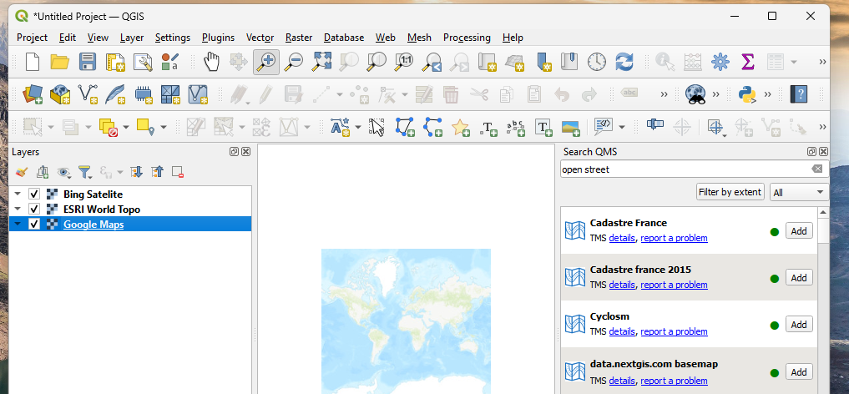
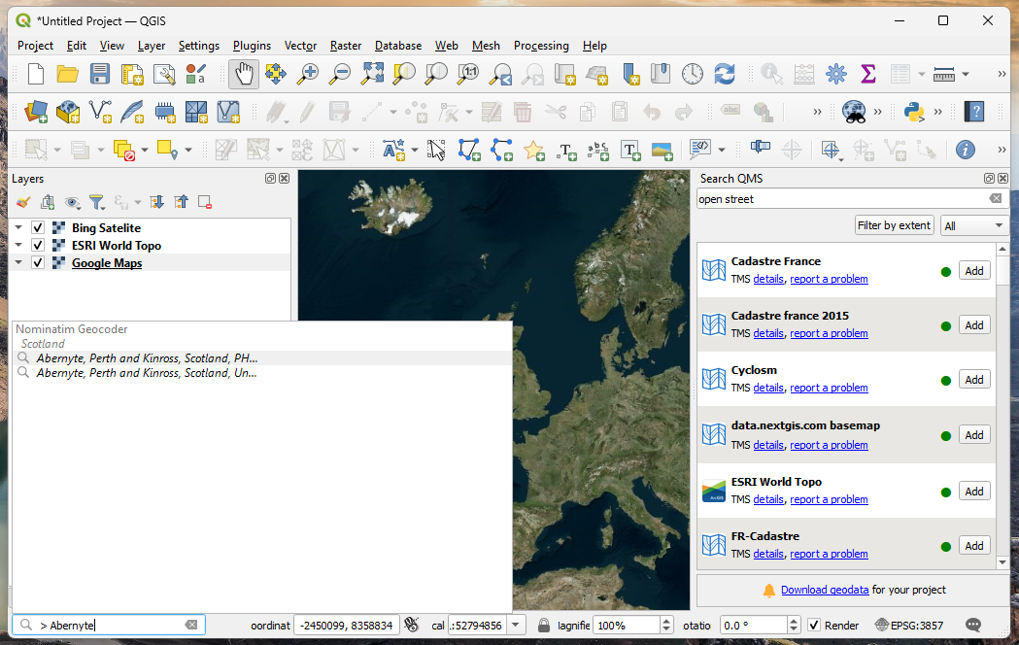
Notes:
But where are we? Can you locate where we are in the World?
If your geographical knowledge is good you should able to zoom in and pan. Click on the + in the magnifying glass symbol (red box), then click and drag a square of where you want to zoom too. If you make a mistake just press the magnifying back button (orange box) or zoom out. Click on the magnifying all arrows to go back to the whole world (green box). Click on the hand (blue box) to move around – just click anywhere on the map, hold down and move the mouse.
If this is tricky, use the search button – in the bottom left corner (red box) type “> ” (note the space) followed by the place name. Then double click on the name from the list that appears above, and magically you will be taken there. Can you find where you are?

Slide 8


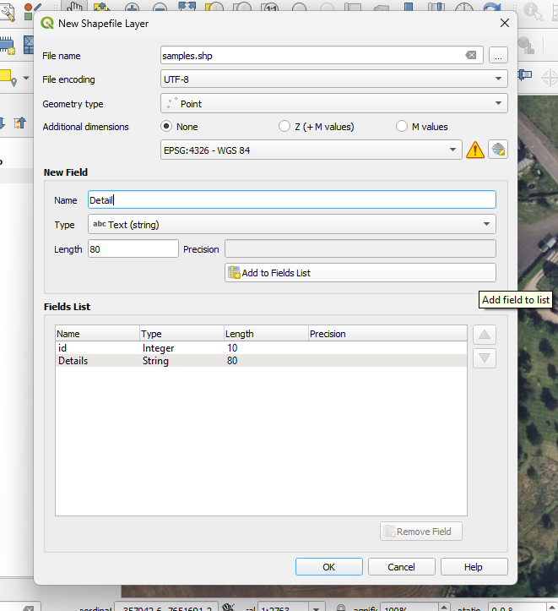
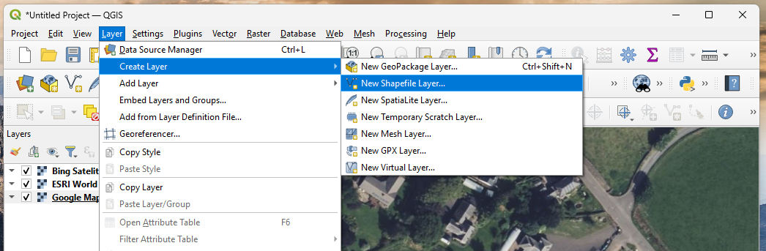
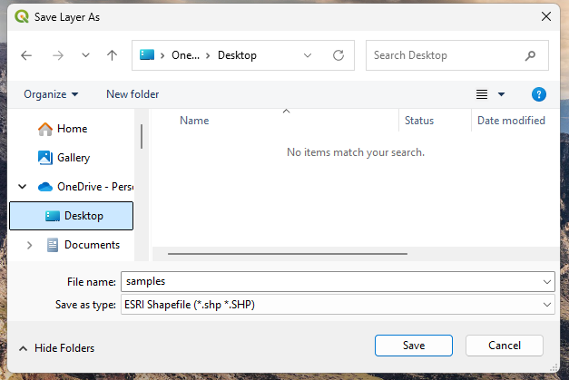
Notes:
One of the best things about GIS is that we can use the computer to draw on our maps to show different things.
We can do this firstly by making a new shapefile (a file that stores points, lines, and polygons), and digitise (draw) some features based on our basemap. To do this:
Go to the “Layer” toolbar, “Create layer”, “New Shapefile Layer”.
In the new window that appears make sure you:
Type a file name e.g. “samples” (red box)
Click on the three dots to the right of this name (orange box). Go to Desktop or another sensible location to save your file (see orange bordered image). Click “Save”.
Geometry type = “Point” (green box)
Leave the coordinate reference system as EPSG: 4326 – WGS 84 (blue box)
Under “New Field” box type a name like “Details” (leave the type as Text (string), and the length 80). Click “Add to Fields list”. This makes a new column in our file, a bit like a 2nd column on our Excel sheet. (purple box)
Click OK.

Slide 9

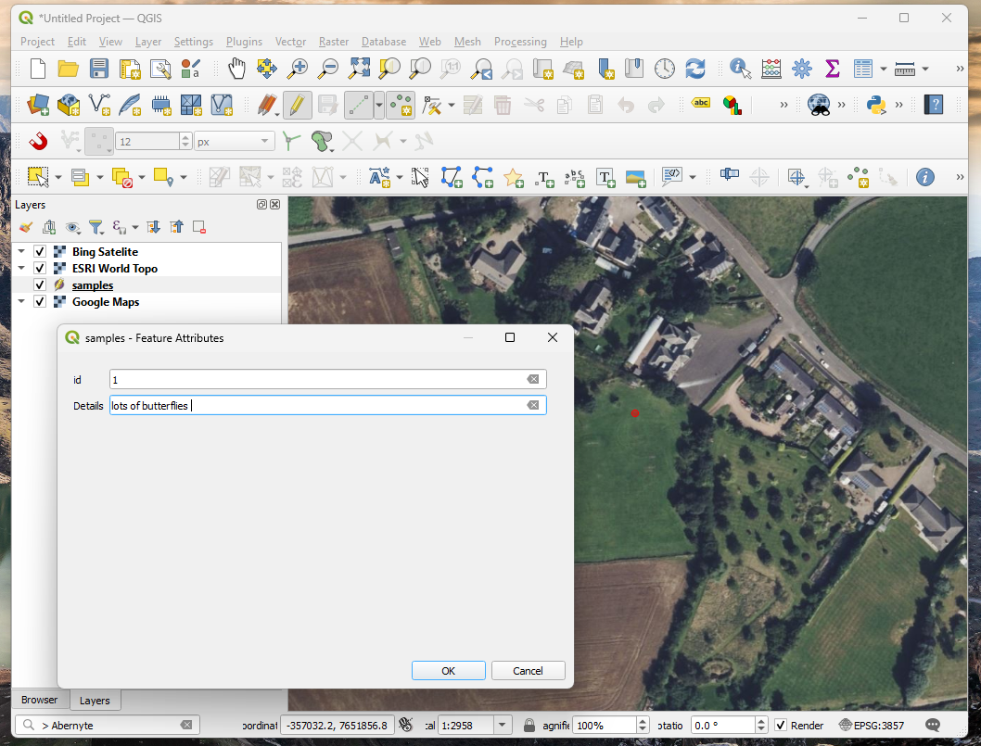
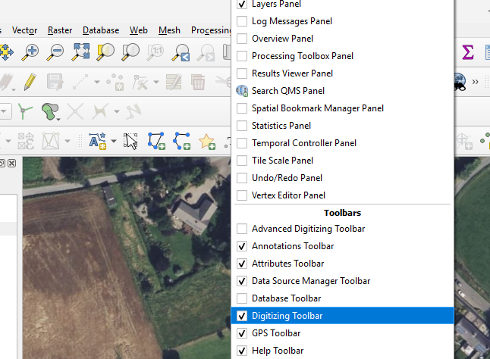

Notes:
Now right click on empty toolbar space (anywhere light grey towards the top). Make sure the “Digitizing Toolbar” is ticked. This will add some new tools to our toolbar (red box).
Did you notice that your new shapefile was added to the Layers menu? Find your new layer on the layer panel (red box below), and click and drag so it is at the top of the layers. Now, click on the yellow pencil (“Toggle Editing”) on the digitising toolbar (orange box).
Click “Add Point Feature” (the three green blobs, green box). Click on the map where you would like your point to be e.g. where you took a measurement (red dot). Enter an ID e.g. 1 and some details e.g. “Lots of butterflies” (blue box). Click OK. Make sure you “Save Layer Edits” (the floppy disk symbol, purple box) before clicking on the yellow pencil again (orange box) to stop editing.

Slide 10

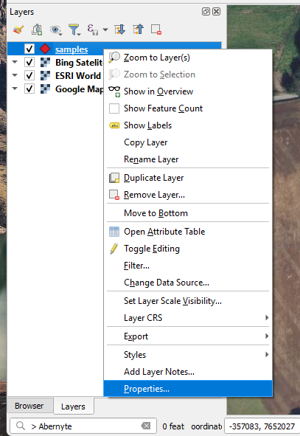
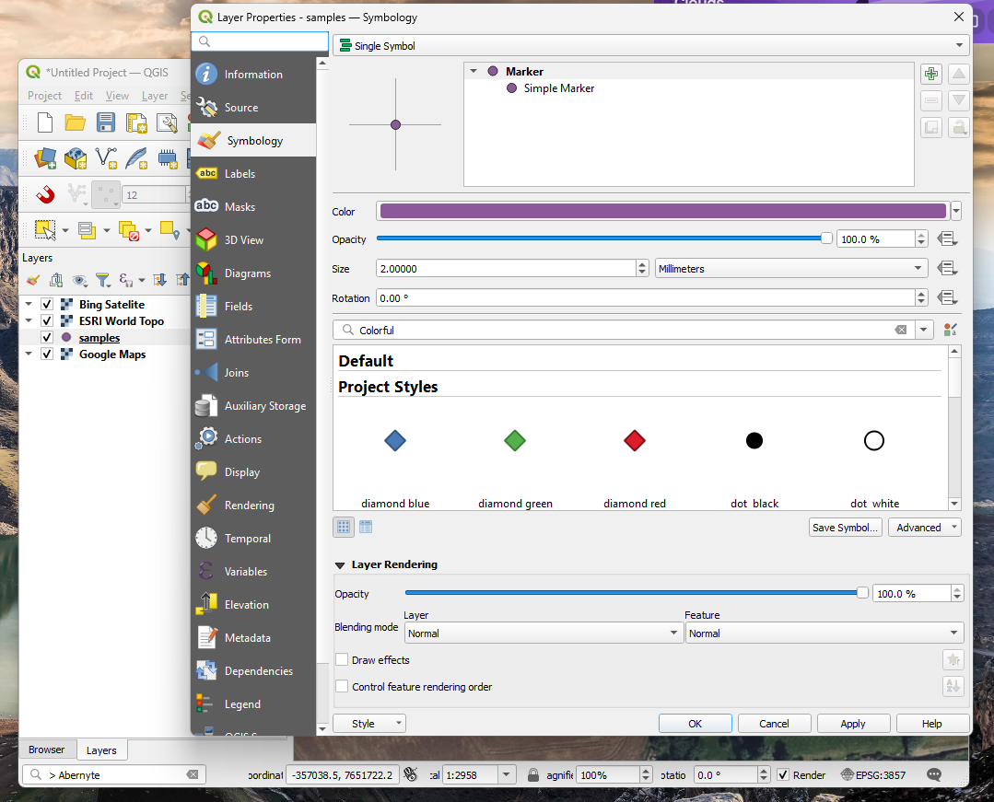
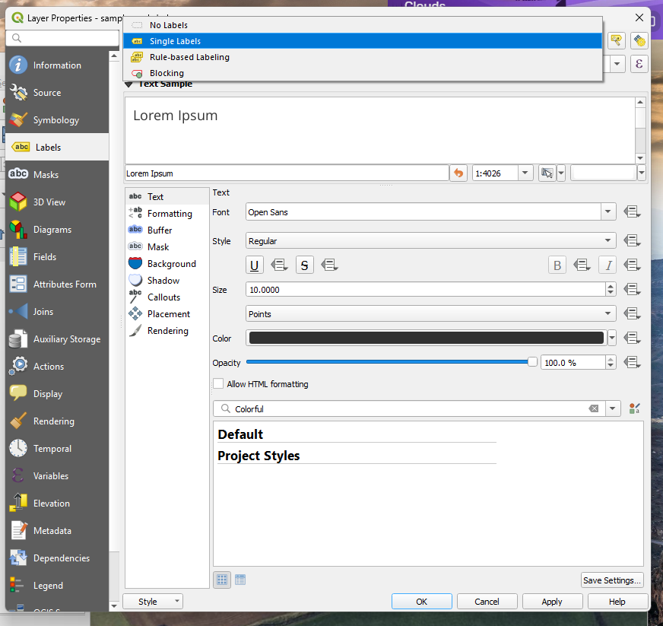
Notes:
Once we have added our points we can change the colours of them:
Double click on the coloured dot next to our new layer (red box).
Look at the different symbol options and click on one, then OK. #
We can also add labels next to them by:
Right click on the layer and go to Properties.
Click on the labels tab (orange box).
Select “Single Labels” from the drop down menu (green menu).
Make sure the ‘Value’ is your 2nd column (“Details”).
Change the font etc. then click OK.

Slide 11

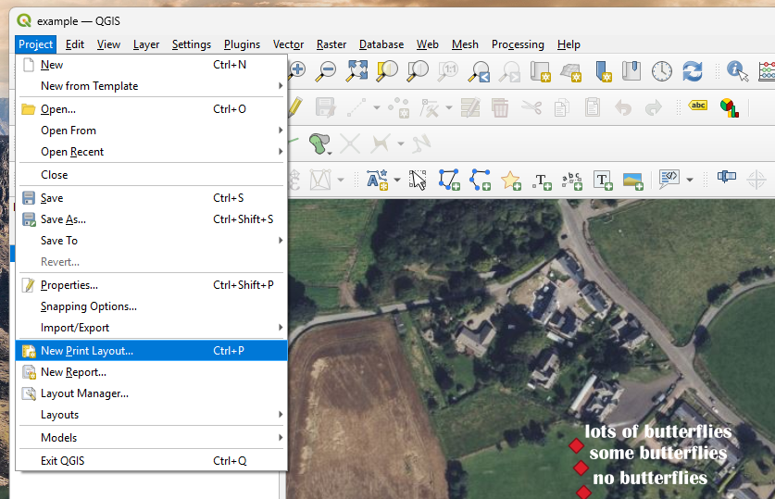
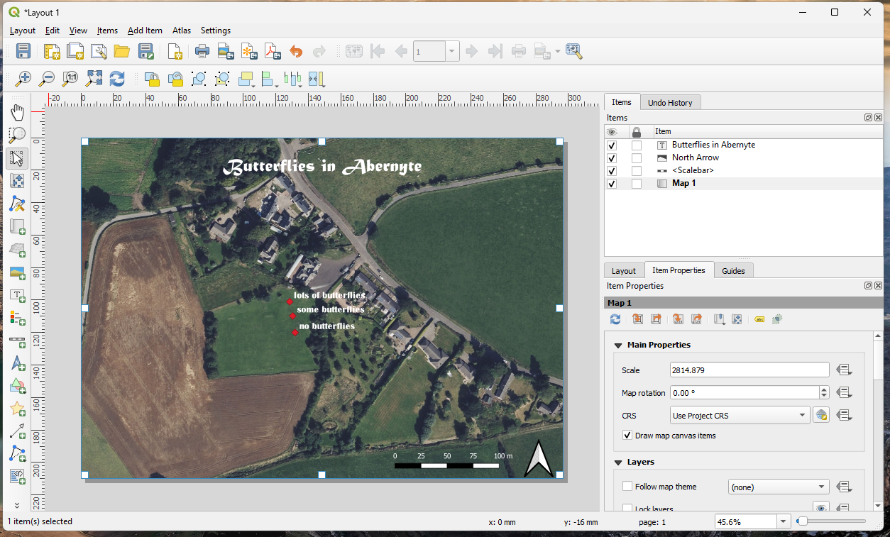
Notes:
Now we should have all the layers we need in our QGIS. By how do we make and save a map to share with others?
First, go to the “Project” toolbar and select “New print layout”.
This opens a new layout window, which you can give this a title if you wish. Press OK.
In this new window, click on the “Add map” icon (red box), then click and drag to cover the whole page. You can change the scale (how zoomed in the map is) using the item properties box (orange box) – just change the scale number (but be careful not to change it too much!)
You could improve your map by adding a title using the add text button (green box). Click the add text button and then click and drag where you would like the text to be. Then type in the item properties (orange box). There is also the font option in this box which lets you change the font size, colour, and type.
Maps usually have a scale bar (to show you how big things really are) and a north arrow to help people orientate themselves. You can add these by clicking on their symbols in the blue box then clicking and dragging on your map to where you want them.
Once you are happy with you map click Layout (purple box) -> Export as Image. Type a file name e.g. my map, make sure the desktop folder is selected and the file type is jpeg format. Click Save, then Save again. And Voila you have made your own map!

Slide 12

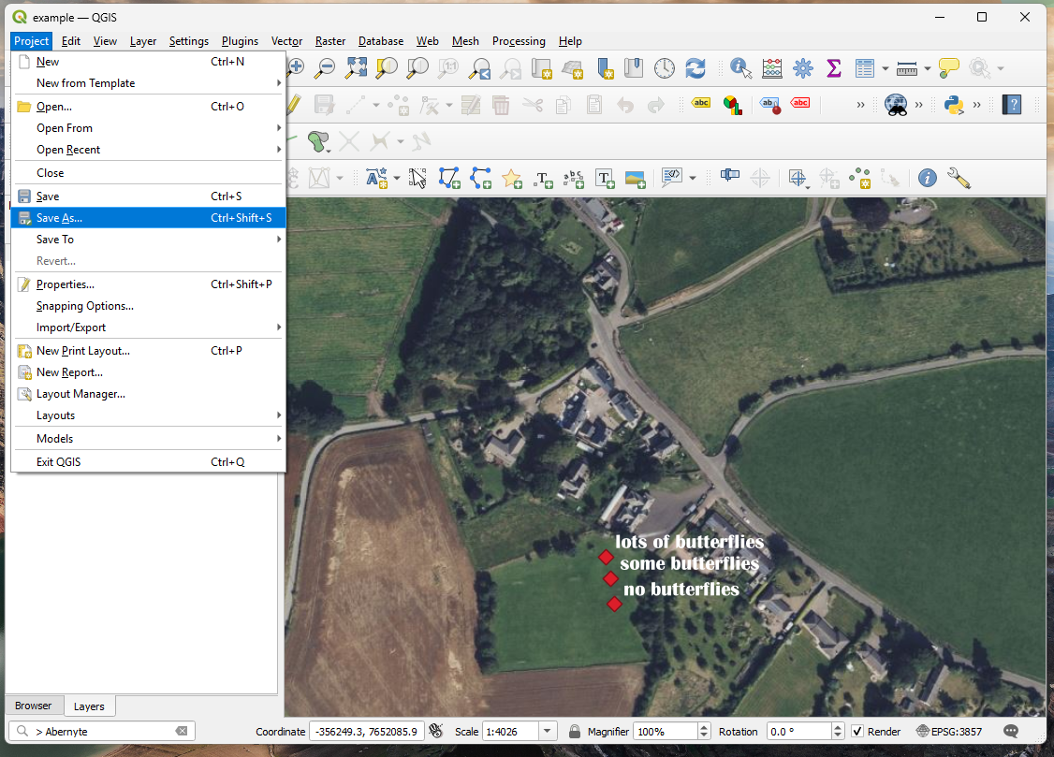
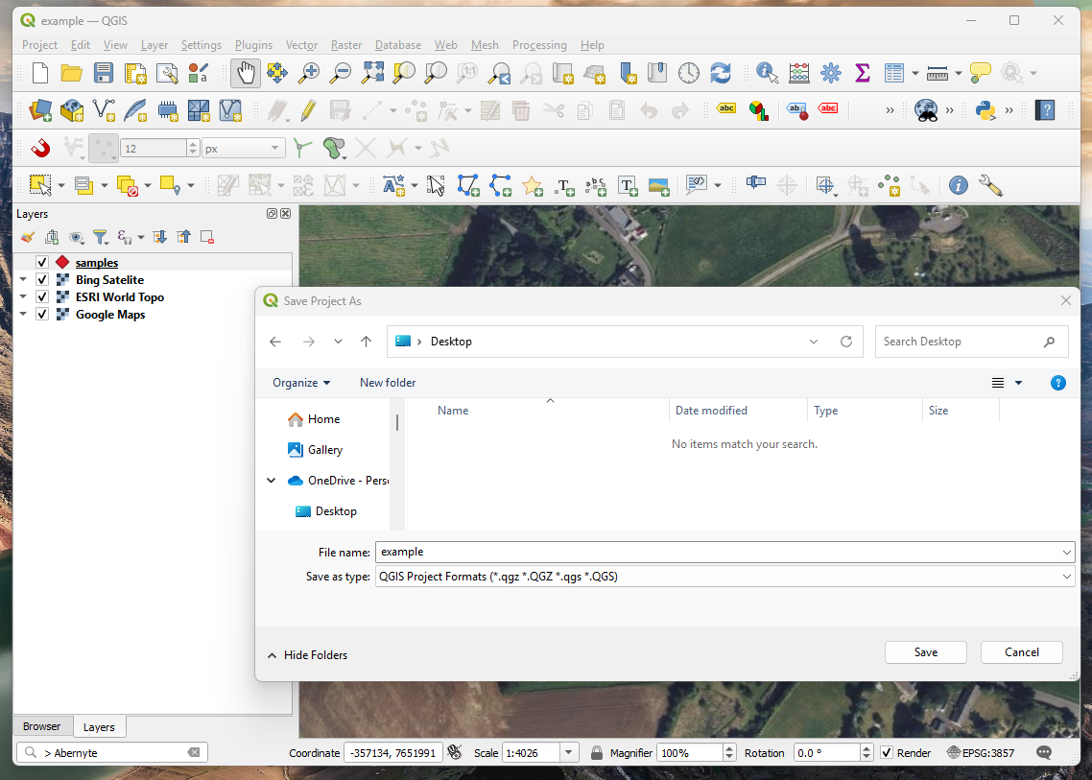
Notes:
One last thing. Always remember to save your work.
In your main QGIS window click the project menu and then Save As.

Slide 13

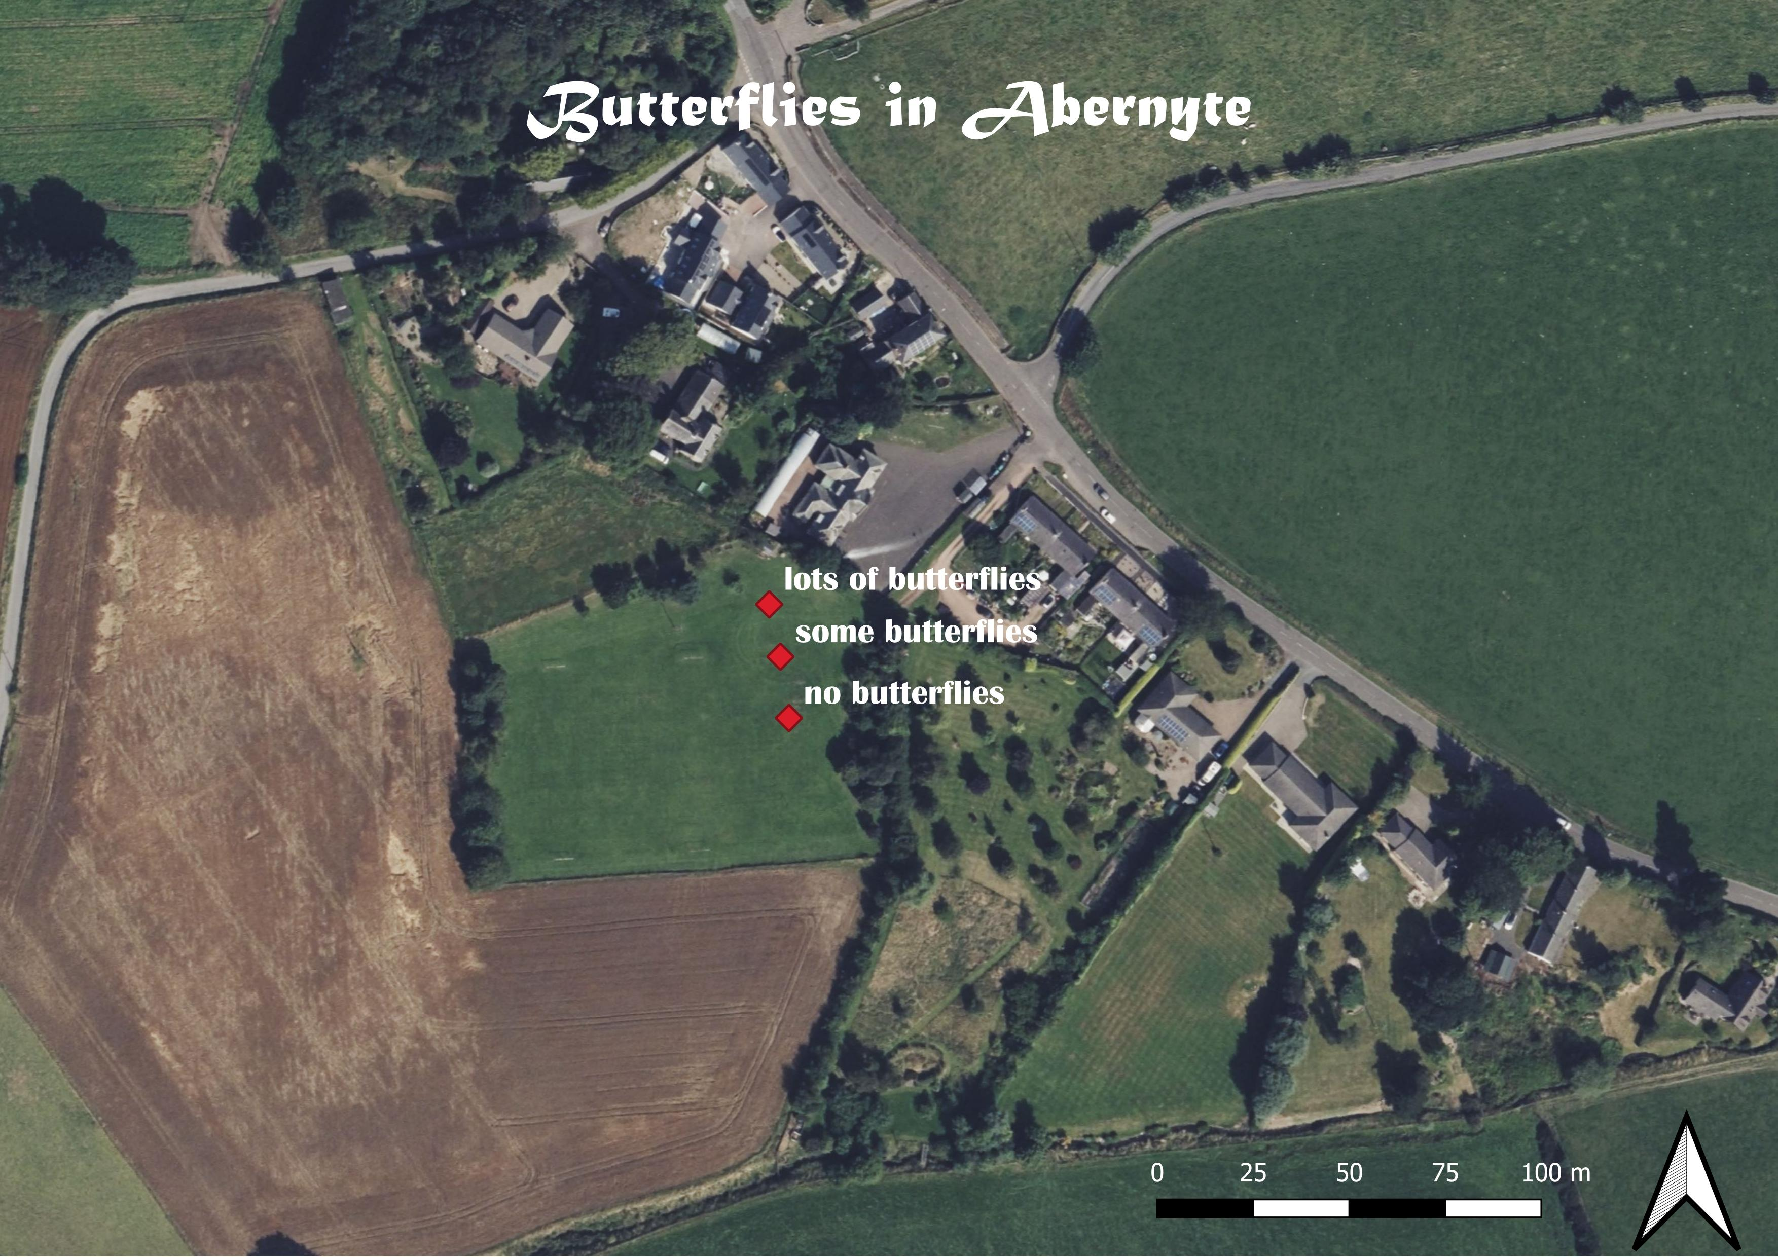



For instructions go to:
https://www.future-environmental-data-scientists.com/lesson-5-data-analysis-mapping
Notes:
Step 1: Download and open QGIS
Step 2: Load some background maps
a) Install QMS plugin
b) Choose some maps
c) Find where you are
Step 3: Draw extra layers on your map
a) Create a shapefile
b) Draw locations
c) Make it look pretty
Step 4. Make and save a map

